Slide 1

BANGALORE INSTITUTE OF TECHNOLOGY
K.R Road, V.V Pura, Bengaluru-04
DEPARTMENT OF ARTIFICIAL INTELLIGENCE & MACHINE LEARNING
“Brain Computer Interfaces”
Presented by
USN Name
1BI20AI055 Vishal S B
VIII Semester
Under the Guidance of
Prof. Yamini Sahukar P
Assistant Professor

Slide 2
Agenda
Introduction
Literature Review
Problem Statement
Proposed System
Architecture
Methodology/Algorithm
Results (Graph / Tables)
Applications
Conclusion
References

Slide 3
Introduction to topic
BCIs establish direct brain-device communication.
They collect brain signals, interpret user intent, and execute commands.
Applications include neurofeedback, restoring motor functions, communication for locked-in patients, and sensory enhancement.
BCIs are categorized into non-invasive, semi-invasive, and invasive types.
Non-invasive BCIs use scalp sensors, semi-invasive place electrodes on the brain surface, and invasive BCIs insert micro-electrodes into the cortex.
Non-invasive BCIs are the least risky but may offer lower signal clarity compared to invasive methods.
Invasive BCIs provide the most precise readings and control, but carry higher risks, including infection and tissue damage.

Slide 4
Literature Review
Sl. No. | Title | Author | Year of Publication | Adopted Methodology | Limitations
1. | Unraveling the potential of brain-computer interface technology in medical diagnostics and rehabilitation | Rabie A. Ramadan, Ahmed B. Altamimi | 2024 | This paper conducts an extensive literature review to examine the applications of Brain-Computer Interface (BCI) technology in rehabilitation and medical diagnostics. The paper aims to address the requirements for enhanced accessibility, usability, and accuracy of the utilized BCI approaches. | This paper identifies that users with neurological impairments may encounter challenges in perceiving or recognizing visual feedback from the BCI, potentially hindering their ability to effectively control the system.
2. | A Novel Data Augmentation Approach Using Mask Encoding for Deep Learning-Based Asynchronous SSVEP-BCI | W. Ding, A. Liu, L. Guan and X. Chen | 2024 | In this study, we propose a novel data augmentation approach called EEG Mask Encoding (EEG-ME) to enhance the performance of DL-based SSVEP classification algorithms. A randomly positioned continuous segment is chosen as the mask window, and the value of the EEG data in the mask window is set to 0 | This paper highlights the susceptibility of EEG signals to interference from muscle movements, eye blinks, and environmental noise, thereby introducing inaccuracies that can undermine the reliability of FES activation.
5/20

Slide 5
Literature Review
Sl. No. | Title | Author | Year of Publication | Adopted Methodology | Limitations
3. | Implementation of a Brain-Computer Interface on a Lower-Limb Exoskeleton | C. Wang, X. Wu, Z. Wang and Y. Ma | 2019 | The FES system consists of a MOTIONSTIM8 stimulator from Medel GmbH, Hamburg, Germany, designed for motor rehabilitation applications. | This paper discusses the variability in users' ability to consistently generate motor imagery (MI) patterns. Such variability can challenge the reliability of BCI control as some individuals struggle to maintain consistent MI tasks.
4. | Ternary Near-Infrared Spectroscopy Brain-Computer Interface With Increased Information Transfer Rate Using Prefrontal Hemodynamic | J. Shin, J. Kwon, J. Choi and C | 2018 | The system includes a visual user interface to guide users through the experiment and provide visual feedback based on their BCI performance. | This paper addresses the difficulty in distinguishing between voluntary motor imagery-evoked sensorimotor rhythms (SMRs) and FES-driven passive movement-evoked SMRs.
5/20

Slide 6
Literature Review
Sl. No. | Title | Author | Year of Publication | Adopted Methodology | Limitations
5. | Brain–computer interface: trend, challenges, and threats | Baraka Maiseli, Abdi T. Abdalla, Libe V. Massawe | 2023 | The system detects whether the user is imagining the grasping movement of the left or right hand from ongoing EEG signals and activates the FES to move the corresponding hand. | This paper underscores the critical need for low-latency feedback between BCI commands and FES activation. Delays in feedback can significantly impact real-time control and user experience.
6. | Trial Regeneration With Subband Signals for Motor Imagery Classification in BCI Paradigm | M. K. I. Molla, S. K. Saha, S. Yasmin, M. R. Islam and J. Shin | 2021 | In this paper, the features extracted from subband signals of multichannel EEG are used in MI classification. Instead of using the original signals of different channels, the subband signals are arranged for feature extraction. The mWT is applied to implement data adaptive subband decomposition of EEG signals.. | BCI systems often struggle with capturing fine-grained neural activity, leading to limited signal resolution and potentially reducing the precision of user commands.
5/20

Slide 7
Literature Review
Sl. No. | Title | Author | Year of Publication | Adopted Methodology | Limitations
7. | Application of Artificial Intelligence Techniques for Brain–Computer Interface in Mental Fatigue Detection | H. Yaacob, F. Hossain, S. Shari, S. K. Khare, C. P. Ooi and U. R. Acharya | 2023 | In the following paper, the Preferred Reporting Items for Systematic Reviews and Meta-Analysis (PRISMA) method used in this review is described. The various machine learning and deep learning models employed for automated fatigue detection are discussed. Also, the challenges faced and future directions are presented. | This paper discusses the challenge of limited signal resolution in BCI systems, which can compromise the precision of user commands and limit the range of tasks that can be performed effectively.
8. | Brain-Computer Interface Controlled Functional Electrical Stimulation | Luis G. Hernandez-Rojas; Jessica Cantillo-Negrete | 2021 | The interface controller receives the labels generated by the RLDA model and determines if the FES device has to be activated. | This paper highlights the considerable training time and expertise required for users to operate BCI systems proficiently, restricting accessibility to individuals with specialized training or cognitive abilities.
5/20

Slide 8
Literature Review
Sl. No. | Title | Author | Year of Publication | Adopted Methodology | Limitations
9. | Design and Implementation of an Asynchronous BCI System With Alpha Rhythm and SSVEP | L. Zhang, X. Wu, X. Guo, J. Liu and B. Zhou | 2019 | The operation of the BCI requires a set of processing steps (EEG preprocessing, feature extraction, classification model, and interface controller) in order to determine when the mental task is done. | This paper examines the impact of environmental factors such as electromagnetic interference, ambient noise, and lighting conditions on BCI signal acquisition and processing, highlighting challenges to system reliability and performance.
10. | Virtual Reality Cognitive Gaming Based on Brain Computer Interfacing: A Narrative Review | M. Hadjiaros, K. Neokleous, A. Shimi, M. N. Avraamides | 2023 | Specifically, we provide an overview of BCI systems that use EEG control signals based on Motor Imagery (MI), the P300 component, and Steady-State Visual Evoked Potentials (SSVEP) and relate to VR Gaming or the cognitive mechanisms of perception, visuospatial attention and visuospatial memory. | This paper explores the challenges of integrating BCI technology into gaming experiences, including latency, accuracy, and user adaptation issues, and discusses their implications for widespread adoption in the gaming industry.
5/20

Slide 9
Literature Review
Sl. No. | Title | Author | Year of Publication | Adopted Methodology | Limitations
11. | A CMOS BD-BCI: Neural Recorder with Two-Step Time-Domain Quantizer and Multi-Polar Stimulator | A. R. Danesh, H. Pu, M. Safiallah, A. H. Do, Z. Nenadic and P. Heydari | 2024 | This work presents a bi-directional brain-computer interface (BD-BCI) including a high-dynamic-range (HDR) two-step time-domain neural acquisition (TTNA) system and a high-voltage (HV) multipolar neural stimulation system incorporating dual-mode time-based charge balancing (DTCB) technique. | Regarding stimulation, the accuracy of the TI scheme is influenced by the precision of the electric field and is not as proficient as techniques found in implantable DBS. Nevertheless, a significant advantage of our approach is the elimination of the need for electrode implantation, thereby mitigating numerous risks related to biocompatibility and ethics.
12. | Improving the Performance of Individually Calibrated SSVEP-BCI by Task- Discriminant Component Analysis | B. Liu, X. Chen, N. Shi, Y. Wang, S. Gao and X. Gao | 2021 | The present study provides a new perspective for designing decoding methods in individually calibrated SSVEP-BCI and presents insight for its implementation in high-speed brain speller applications. | However, in a real-world BCI system, configuring more channels for acquisition would substantially increase the associated cost, which decreases the affordability of the system. Thus, this study uses the classical nine channels for the online experiment.
5/20

Slide 10
Literature Review
Sl. No. | Title | Author | Year of Publication | Adopted Methodology | Limitations
13. | Eliminating or Shortening the Calibration for a P300 Brain–Computer Interface Based on a Convolutional Neural Network | Wei Gao, Weichen Huang, Man Li | 2023 | In this study, we propose an online P300 BCI spelling system with zero or shortened calibration based on a convolutional neural network (CNN) and big electroencephalography (EEG) data. | These experimental results indicated that based on a CNN and big EEG data, an online P300 BCI with zero-calibration or shortened calibration could be built. In future studies, we will extend this system to patients, such as those with strokes or spinal cord injuries, to help them improve their self-care ability.
14. | iTa-DFiE: An Innovative Tensor Algebra-based Detection Framework for Incomplete Noninvasive Electroencephalography | N. T. N. Anh, T. Q. Bang, H. J. Yang, H. T. Hieu, N. T. Q. Vinh and N. K. Duy | 2024 | he paper presents a novel recognition framework for incomplete noninvasive Electroencephalography (EEG) signals relying on the recent advances in tensor algebra, named as An Innovative Tensor Algebra - based Detection Framework for Incomplete Noninvasive Electroencephalogra-phy (iTa-DFiE). | The aforementioned challenge setting is solved on two major thrusts, including: (1) tensor completion: discovering hidden patterns and learning their evolving trends to offer missing values imputation via improvement of standard Kalman Filter approach; (2) tensor decomposition: extracting essential hidden information.
5/20

Slide 11
Literature Review
Sl. No. | Title | Author | Year of Publication | Adopted Methodology | Limitations
15. | A Time-Local Weighted Transformation Recognition Framework for Steady State Visual Evoked Potentials Based Brain–Computer Interfaces | N. Jamil, A. N. Belkacem, S. Ouhbi and C. Guger | 2021 | This study investigates and analyzes the research on BCI patterns and its implementation for enhancing cognitive capabilities of students. The results showed that there is insufficient literature on BCI that addresses students with disabilities in the learning process. | Previous works have proved that time-local information can improve the recognition effect of SSVEP, but its improvement mechanism is not clear. This study proposes a TT recognition framework from the perspective of weighted transformation, it reveals the influence mechanism of time-local information on SSVEP recognition..
5/20

Slide 12
Problem Statement
“Despite the potential of Brain-Computer Interfaces (BCIs) in spinal injury rehabilitation and gaming, challenges persist. These include ensuring user privacy and security, improving signal interpretation accuracy, addressing long-term effects of brain-technology interfacing, and integrating BCIs seamlessly into daily life.“
Objectives:
This paper gives an overview of the current state of Brain-Computer Interfaces, their architecture, and methodology.
This paper gives a detailed analysis of the application of BCIs in the rehabilitation of spinal injuries and nerve issues.
This paper gives insight into the potential of BCIs in the gaming industry and how it can revolutionize the gaming experience.

Slide 13
Proposed System
Signal Acquisition: A high-quality EEG headset for brain signal acquisition.
Signal Processing: Advanced algorithms for noise filtering and feature extraction.
Machine Learning Models: Models trained on large datasets for accurate signal interpretation.
Spinal Injury Rehabilitation: Applications for motor control practice and prosthetic device interfacing.
Gaming Applications: Direct brain signal control of game elements for immersive gaming.
Privacy and Security: Strong measures to protect sensitive brain data..

Slide 14
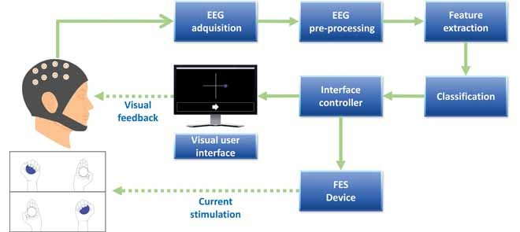
Architecture

Slide 15
Architecture
EEG Cap: A wearable device with electrodes that captures brain signals from the scalp.
EEG Acquisition: The initial stage where raw EEG data is collected from the EEG cap.
EEG Pre-processing: Noise filtering and signal enhancement to prepare data for analysis.
Feature Extraction: Identifying significant features from EEG signals for interpretation.

Slide 16
Architecture
Classification: Categorizes brain signals to match intended user actions.
FES Device: Functional Electrical Stimulation device that receives BCI commands to assist with movement.
Visual Feedback: Provides real-time feedback to the user, enhancing interaction and control.

Slide 17
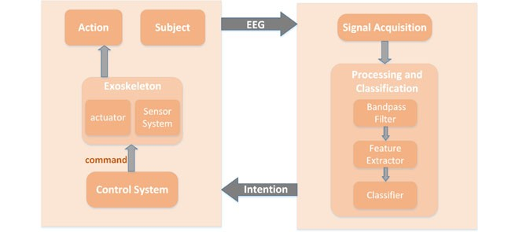
Methodology/Algorithm

Slide 18
Methodology/Algorithm
Intention Recognition: The system starts by identifying the user’s intention to perform a specific action. This is typically done by analyzing the user’s brain activity patterns that correspond to specific thoughts or commands.
Signal Acquisition: Once the user’s intention is recognized, EEG signals are acquired from the user’s brain. These signals are electrical activities generated by the brain, captured using electrodes placed on the scalp.
Signal Processing: The acquired signals are then processed. This involves bandpass filtering, which removes noise and unwanted frequencies from the signals.

Slide 19
Methodology/Algorithm
Classification: The processed signals are then classified. This involves using machine learning algorithms to categorize the signals into specific classes that correspond to different commands or actions intended by the user.
Control System Activation: Based on the classification results, the control system is activated. This system is responsible for translating the classified signals into commands that can be understood and executed by the exoskeleton.

Slide 20
Methodology/Algorithm
Exoskeleton Response: Upon receiving the commands from the control system, the exoskeleton actuator sensor system executes the intended action. This could involve movement of specific parts of the exoskeleton to assist the user.
Feedback Loop: Finally, the system provides feedback to the user about the action performed by the exoskeleton. This allows the user to adjust their thoughts or commands if the action performed by the exoskeleton does not match their intention, thereby enhancing the interaction between the user and the system.

Slide 21

Results
Training accuracies were estimated with a 5-fold cross-validation for each participant and session.
For healthy subjects, the mean accuracy for the Left MI was 64%, for the Right MI was 61%, for Rest was 59% and the overall classification accuracy was 61%.
Only two participants showed accuracies below of 50% in all the sessions they conducted (HS1 and HS2).
The remaining participants exhibited accuracies above 60% in at least one of the sessions.

Slide 22
Results
For the healthy subjects, in the Left MI trials, 6 of 7 subjects reached online accuracies above 85% (HS2-7) in at least one session.
The same 6 healthy subjects achieved an online accuracy of 100% in at least one session for Right MI trials.
SC1 reached online accuracies between 27% to 87% for Left MI trials with a mean rate of 63%.
In the SC2 case, online accuracy values were above 80% for all MI conditions, with mean values of 91% and 93% for Left and Right MI conditions, respectively.

Slide 23
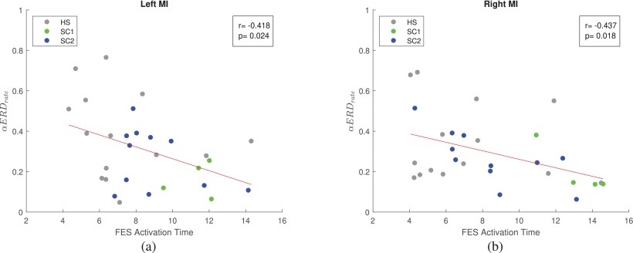
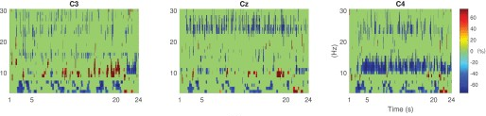
Results

Slide 24
Applications
Medical Applications: BCIs can be used to restore useful function for people who have developed neuromuscular disorders, such as amyotrophic lateral sclerosis, cerebral palsy, stroke, or spinal cord injury1. They can also be used for conditions that involve monitoring or correcting abnormal brain signaling.
Movement and Communication: BCIs have applications for any condition that involves movement or communication impairments, because the interface could signal their intentions to a machine that could carry out those functions.

Slide 25
Applications
Security and Lie Detection: BCIs are being explored in applications as diverse as security, lie detection.
Alertness Monitoring: They can be used for alertness monitoring.
Gaming: BCIs can be used in the gaming industry to create more immersive experiences.
Education and Art: BCIs can be used in education and art to create new ways of learning and expressing creativity.
Human Cognition Augmentation: BCIs can be used to augment human cognition.

Slide 26
Conclusion
BCIs have shown significant promise in restoring mobility and communication in individuals with spinal injuries and nerve damage. By bypassing the damaged pathways, BCIs can provide a new method for these individuals to interact with the world.
Beyond spinal injuries and nerve damage, BCIs have broad medical applications. They can be used to monitor and correct abnormal brain signaling, making them potentially useful in treating a variety of neurological disorders.
BCIs can be particularly beneficial for individuals with movement or communication impairments, providing a new way for them to signal their intentions to a machine that can carry out those functions.

Slide 27
References
[1] Ramadan, R.A., Altamimi, A.B. Unraveling the potential of brain-computer interface technology in medical diagnostics and rehabilitation: A comprehensive literature review. Health Technol. 14, 263–276 (2024)
[2] W. Ding, A. Liu, L. Guan and X. Chen, "A Novel Data Augmentation Approach Using Mask Encoding for Deep Learning-Based Asynchronous SSVEP-BCI," in IEEE Transactions on Neural Systems and Rehabilitation Engineering, vol. 32, pp. 875-886, 2024
[3] C. Wang, X. Wu, Z. Wang and Y. Ma, "Implementation of a Brain-Computer Interface on a Lower-Limb Exoskeleton," in IEEE Access, vol. 6, pp. 38524-38534, 2018
[4] J. Shin, J. Kwon, J. Choi and C. -H. Im, "Ternary Near-Infrared Spectroscopy Brain-Computer Interface With Increased Information Transfer Rate Using Prefrontal Hemodynamic Changes During Mental Arithmetic, Breath-Holding, and Idle State," in IEEE Access, vol. 6, pp. 19491-19498, 2018

Slide 28
References
[5] Maiseli, B., Abdalla, A.T., Massawe, L.V. et al. Brain–computer interface: trend, challenges, and threats. Brain Inf. 10, 20 (2023)
[6] M. K. I. Molla, S. K. Saha, S. Yasmin, M. R. Islam and J. Shin, "Trial Regeneration With Subband Signals for Motor Imagery Classification in BCI Paradigm," in IEEE Access, vol. 9, pp. 7632-7642, 2021
[7] H. Yaacob, F. Hossain, S. Shari, S. K. Khare, C. P. Ooi and U. R. Acharya, "Application of Artificial Intelligence Techniques for Brain–Computer Interface in Mental Fatigue Detection: A Systematic Review (2011–2022)," in IEEE Access, vol. 11, pp. 74736-74758, 2023
[8] L. G. Hernandez-Rojas et al., "Brain-Computer Interface Controlled Functional Electrical Stimulation: Evaluation With Healthy Subjects and Spinal Cord Injury Patients," in IEEE Access, vol. 10, pp. 46834-46852, 2022

Slide 29
References
[9] S. Park, H. -S. Cha and C. -H. Im, "Development of an Online Home Appliance Control System Using Augmented Reality and an SSVEP-Based Brain–Computer Interface," in IEEE Access, vol. 7, pp. 163604-163614, 2019
[10] M. Hadjiaros, K. Neokleous, A. Shimi, M. N. Avraamides and C. S. Pattichis, "Virtual Reality Cognitive Gaming Based on Brain Computer Interfacing: A Narrative Review," in IEEE Access, vol. 11, pp. 18399-18416, 2023
[11] B. Liu, X. Chen, N. Shi, Y. Wang, S. Gao and X. Gao, "Improving the Performance of Individually Calibrated SSVEP-BCI by Task- Discriminant Component Analysis," in IEEE Transactions on Neural Systems and Rehabilitation Engineering, vol. 29, pp. 1998-2007, 2021
[12] B. Liu, X. Chen, N. Shi, Y. Wang, S. Gao and X. Gao, "Improving the Performance of Individually Calibrated SSVEP-BCI by Task- Discriminant Component Analysis," in IEEE Transactions on Neural Systems and Rehabilitation Engineering, vol. 29, pp. 1998-2007, 2021

Slide 30
References
[13] W. Gao et al., "Eliminating or Shortening the Calibration for a P300 Brain–Computer Interface Based on a Convolutional Neural Network and Big Electroencephalography Data: An Online Study," in IEEE Transactions on Neural Systems and Rehabilitation Engineering, vol. 31, pp. 1754-1763, 2023
[14] N. T. N. Anh, T. Q. Bang, H. J. Yang, H. T. Hieu, N. T. Q. Vinh and N. K. Duy, "iTa-DFiE: An Innovative Tensor Algebra-based Detection Framework for Incomplete Noninvasive Electroencephalography," in IEEE Access, doi: 10.1109/ACCESS.2024
[15] K. Qin, R. Xu, S. Li, X. Wang, A. Cichocki and J. Jin, "A Time-Local Weighted Transformation Recognition Framework for Steady State Visual Evoked Potentials Based Brain–Computer Interfaces," in IEEE Transactions on Neural Systems and Rehabilitation Engineering, vol. 32, pp. 1596-1605, 2024

